Slide 1
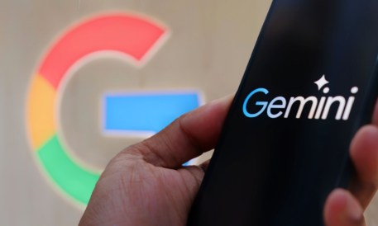
Healthcare Privacy Analysis of Google Gemini Ai
Group 1
Hudson Cole, Michael Garza, Natalia Hernandez, Samuel Hilliard
Collin College
CYBR 4350-003: Senior Project
Manny Hameed

Slide 2

Project Scope
Project Overview
AI is becoming prevalent throughout healthcare organizations
Project aimed at understanding how sensitive data is handled when uploaded into AI-driven environments
We Examined:
How data privacy is managed when using Google’s Gemini AI within Texas healthcare providers
Simulated real-world scenario by inserting sample data. Assess whether Gemini AI follows privacy standards and regulatory frameworks set by the state of Texas

Slide 3
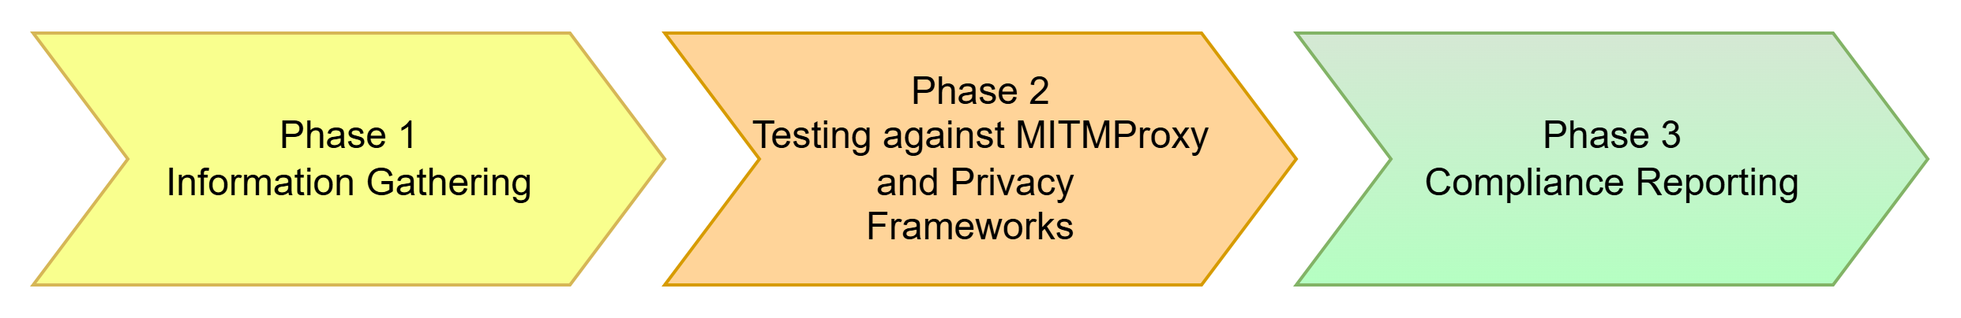
Project Summary
Methodology
Gemini AI evaluation will be conducted using a structured three-phase checklist:
  Phase 1: Review Google's open-source privacy policy
  Phase 2: Network monitoring and data transmission analysis
  Phase 3: Final validation against privacy and security standards

Slide 4
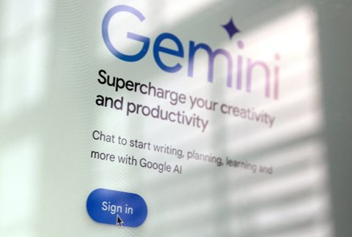
Phase 1 Review
Gathered, analyzed and strategically aligned peer-reviewed and timely scholarly articles as well as reputable open-source material related to:
  Gemini AI's Capabilities & Limitations
  Data Privacy Laws & Regulations
    TDPSA
Discovered potential misalignment between Gemini's data handling and Texas Data Privacy and Security Act (TDPSA) mandates.
TDPSA requires strict transparency, opt-in consent, and purpose limitation.

Slide 5
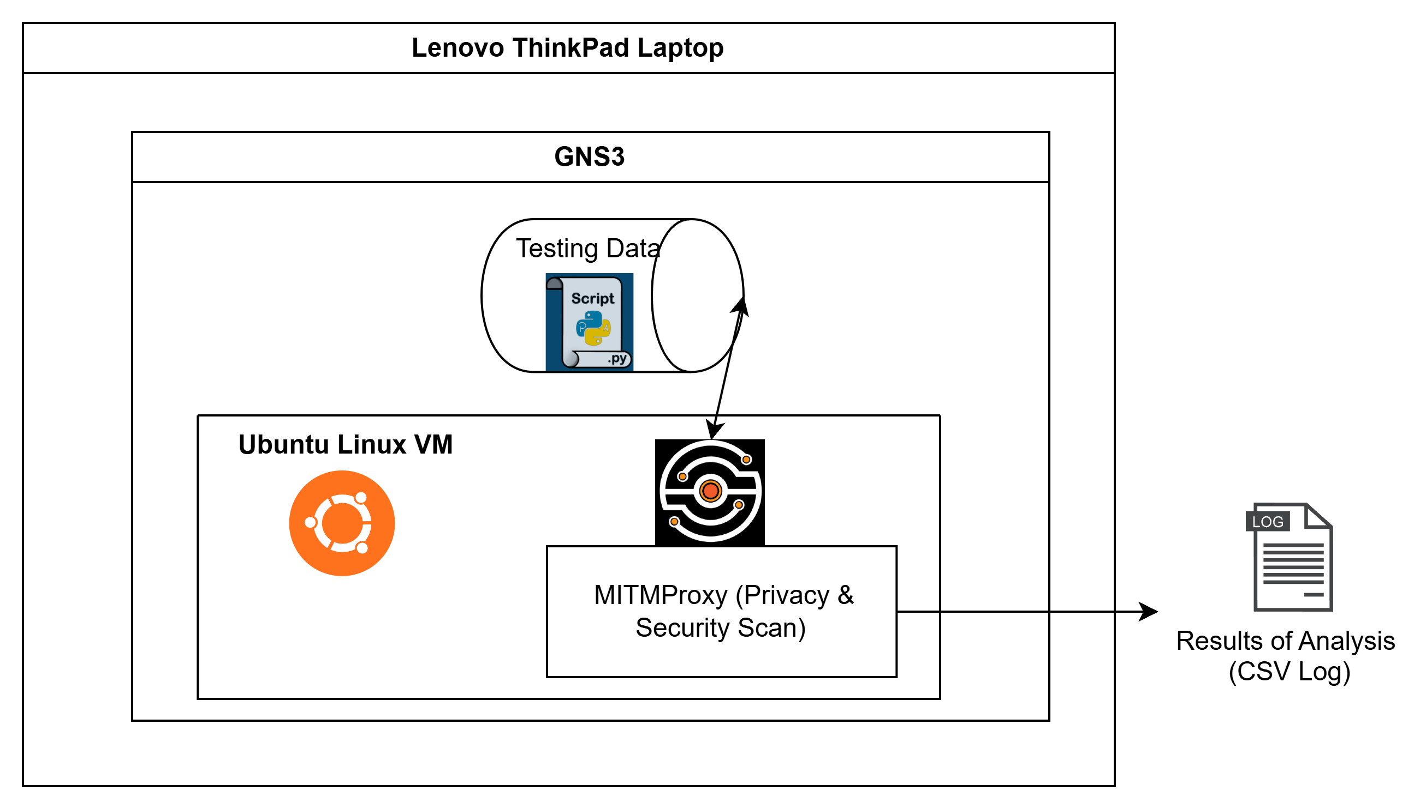
Configuration of Phase 2
Hosted on a local desktop, Lenovo ThinkPad. Testing performed within virtual network environment using GNS3, running a Linux Ubuntu application.
GNS3 is a networking simulator that creates virtual environments built on virtual machines for testing purposes.
Within Ubuntu's Terminal window, MITMProxy (Man In The Middle Proxy) intercepted and collected sensitive data from Gemini AI Chatbot using a custom Python script.
Captured network traffic into a CSV log.
Figure 1.

Slide 6
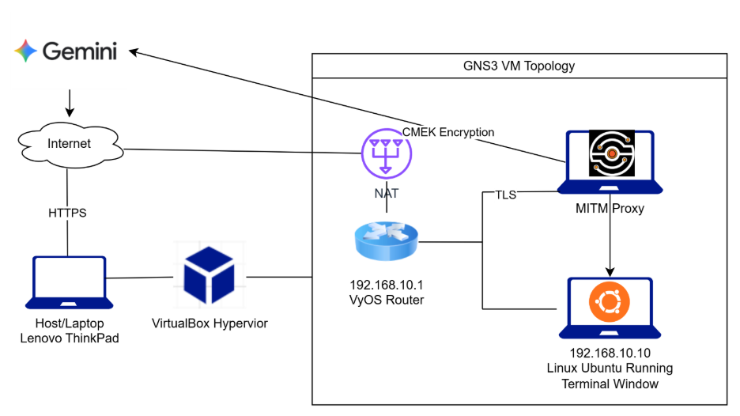
Phase 2 Network Architecture
Host accesses internet via VyOS Router and enables our team to use Hypervisor with GNS3
Linux Ubuntu Running Terminal is used to access MITMProxy
MiTMProxy enables our team to observe Gemini's actions on test-data
Figure 2.
Notes:
-Data Compliance Monitoring and Segmentation
-In a modern healthcare environment, the greatest threat isn't always an outside attacker—it’s often internal 'Data Sprawl.' By removing the Attacker node, we’ve pivoted our architecture to demonstrate Zero-Trust Microsegmentation. We have physically and logically separated our 'Processing' layer (Ubuntu) from our 'Audit' layer (MITMProxy).
-VLAN Separation:
-Notice the separation between VLAN 10 and VLAN 20. By keeping our Gemini analysis node on its own VLAN, we ensure that no other service on the network can 'sniff' the sensitive patient data we are processing. The only way in or out of that segment is through the VyOS Router, which acts as our Policy Enforcement Point.
-Traffic Flow
-The traffic flow here is strictly controlled. When our Ubuntu node sends a prompt to Gemini, the VyOS router intercepts that packet and forces it through the MITMProxy on a separate subnet. This 'Hairpin' routing ensures that every single bit of data is inspected for HIPAA compliance before it ever leaves our virtual hospital.
-Security Value
-This demonstration proves that even without an active threat present, the Architecture itself is a security control. By using subnets like 10.0.10.x and 10.0.20.x, we've created a predictable, auditable network where 'unknown' or 'shadow' traffic is blocked by default.

Slide 7
Phase 2 Environment Security Controls
Our project environment utilizes a Type-2 Hypervisor (VirtualBox), to simulate isolation from host production environments and manage test infrastructure
Gemini is accessed via the MITM Proxy with CMEK encryption
VyOS Router and the Linux Ubuntu Terminal Window have assigned IP addresses and communicating via TLS connections
We don't utilize VLANs in our local and VM environments due to not needing a switch to segment infrastructure devices
Figure 2.
Notes:
Virtual Laboratory Framework: The entire environment is deployed within a Type-2 Hypervisor (VirtualBox), providing a hardware-abstracted layer that ensures the simulation is isolated from any production host environment.
Centralized Network Management (VyOS): A dedicated VyOS Network Appliance serves as the core "Network Operating System," handling all routing, inter-VLAN communication, and firewall policy enforcement between the testing nodes.
VyOS is an open-source Network Operating System (NOS) based on Debian GNU/Linux that provides a professional-grade, software-based router, firewall, and VPN platform.
Unlike traditional hardware routers from companies like Cisco or Juniper, VyOS is designed to run on any virtual or physical hardware (x86-64), making it a popular choice for cloud environments, service providers, and complex lab simulations like yours.
Key Roles in Your Healthcare Lab
In your specific project, VyOS isn't just a "router"—it serves as your Centralized Security Gateway. It is the "brain" that manages the following functions:
Inter-VLAN Routing: It bridges the communication between your Clinical Zone (VLAN 10) and your Audit Zone (VLAN 20). Without VyOS, these subnets would be completely deaf to each other.
Traffic Interception: VyOS is configured to catch any data leaving the Ubuntu workstation and "force" it through the MITMProxy. This ensures that no data escapes your "Compliance Tunnel" without being inspected first.
Firewall Policy Enforcement: It uses a Zone-Based Firewall to strictly define what traffic is allowed. For example, you can set a rule that says "Only the Ubuntu node can talk to the Proxy," effectively blocking any other unauthorized traffic.
Network Address Translation (NAT): It provides the internal virtual nodes with access to the real internet so they can reach the Gemini API while keeping their internal IP addresses hidden.
Why VyOS is Preferred for Your Senior Project
Unified CLI: It uses a specialized Command Line Interface (CLI) that is similar to high-end enterprise routers (like Juniper's JunOS). This allows you to manage routing, firewalling, and VPNs all in one place.
Automation-Friendly: It supports tools like Ansible and Terraform, which is great if you want to mention "Infrastructure as Code" in your presentation.
No Hardware Lock-in: Since it's software-based, you can run this entire enterprise-grade network directly inside VirtualBox or GNS3 without needing expensive physical switches.
Presentation Tip: When the judges ask why you chose VyOS, tell them: "We chose VyOS because it provides a carrier-grade, open-source platform that allows us to implement the same Zero-Trust segmentation and traffic inspection found in a modern hospital's data center."

Slide 8
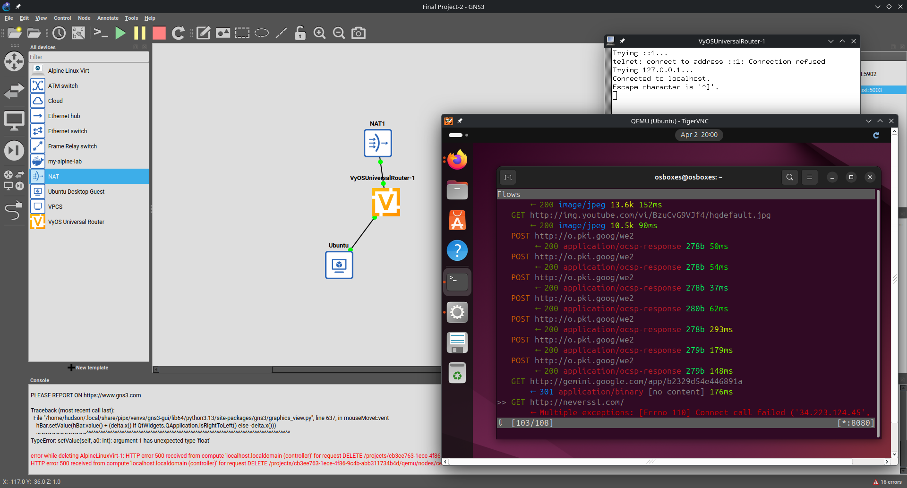
Phase 2 Implementation/
Deployment
Overview of GNS3 environment
NAT -> VyOS Router -> Ubuntu VM -> Terminal Window -> MITMProxy Program
Figure 3.

Slide 9
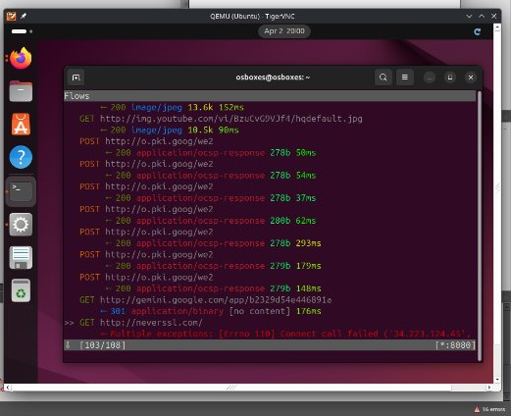
Test Case Execution
Run a test interaction designed to trigger data handling, logging, etc.
MITMProxy test interaction and how it triggered logging.

Slide 10
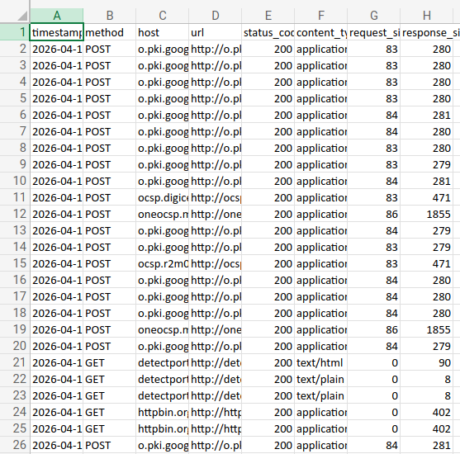
Retrieved Logs

Slide 11
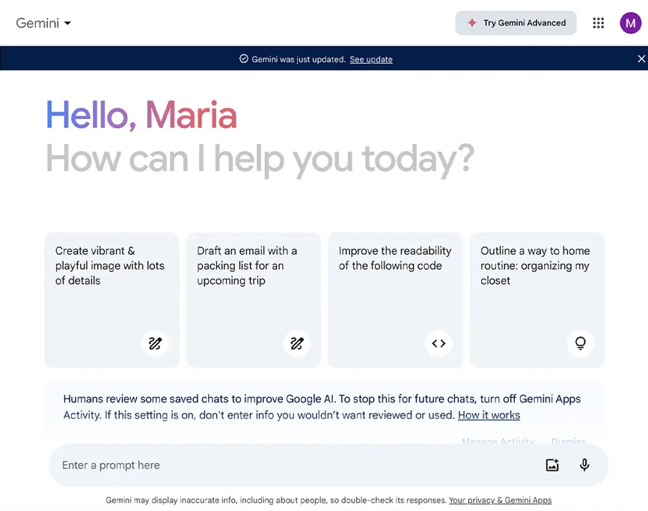
Phase 3: Log Collection and
Preliminary Findings
Certificate Authority (CA) Certificate installed to inspect Google Gemini Ai chatbot.
Deeper inspection suggested a much more concerning and interesting behavior.
Gemini Ai is evading our data loss prevention.
Willful evasion data loss prevention poses serious privacy concerns.

Slide 12
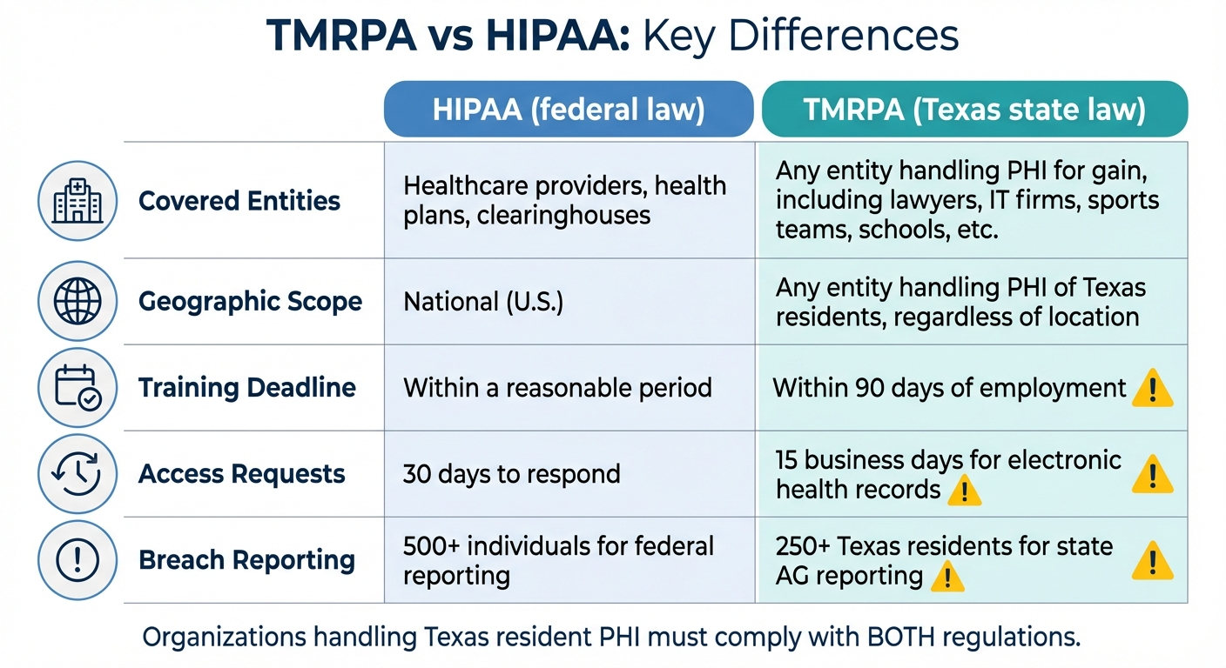
Phase 3 Evaluation
Scoping
  Confidentiality data in transit to Google and other domains
    Processes need to be reviewed and approved
    Data at rest stored for hospital business use protected
  Integrity of data
    Texas Data Privacy and Security Act (TDPSA)
      Data Processing Contract with Third Party
      Technical and Physical Access Controls
    Health Insurance Portability and Accountability Act (HIPAA)
      Data Encryption AES 256
      Access Controls
    Texas Medical Records Privacy Act (TMRPA)
      Sec. 182.108. Subchapter C.1 and 2

Slide 13

Phase 3 Regulatory Mapping
Shared Data with Google and other domains
  Business Associate Agreement
  Compliance Certificate
Approved processes
Approved users

Slide 14
References
Censinet. (n.d.). Texas Medical Records Privacy Act: Ultimate guide. Censinet. https://censinet.com/perspectives/texas-medical-records-privacy-act-ultimate-guide
Corrado, G., & Barral, J. (2024, May 15). Advancing medical AI with Med-Gemini. Google Research. https://research.google/blog/advancing-medical-ai-with-med-gemini/
GE HealthCare. (2025, December 3). GE HealthCare and Mayo Clinic unveil GEMINI-RT, a bold research collaboration in radiation therapy and advanced cancer care. https://investor.gehealthcare.com/news-releases/news-release-details/ge-healthcare-and-mayo-clinic-unveil-gemini-rt-bold-research/
Google Cloud. (n.d.). Gemini Enterprise security overview. Google Cloud Documentation. https://docs.cloud.google.com/gemini/enterprise/docs/security-overview
Google Cloud. (n.d.). Security controls for Generative AI | Gemini Enterprise Agent Platform. Google Cloud Documentation. https://docs.cloud.google.com/gemini-enterprise-agent-platform/models/security-controls
Google DeepMind. (2025, November). Frontier safety framework report – Gemini 3 Pro. https://storage.googleapis.com/deepmind-media/gemini/gemini_3_pro_fsf_report.pdf
Google. (2025). Google Workspace and Cloud Identity HIPAA implementation guide. https://services.google.com/fh/files/misc/gsuite_cloud_identity_hipaa_implementation_guide.pdf
HIPAA Journal. (n.d.). What is Texas HB 300? https://www.hipaajournal.com/what-is-texas-hb-300/
MiTMProxy. (2025, October 25). Mobile security simplified. https://mitmproxy.org/
State Bar of Texas. (2025). Articles. https://www.texasbar.com/AM/Template.cfm?Section=articles&ContentID=69386&Template=/CM/HTMLDisplay.cfm

